Slide 1
Python String
Mrs. E. Brindha,
Assistant Professor,
Department of AI&ML,
Jerusalem College of Engineering.

Slide 2
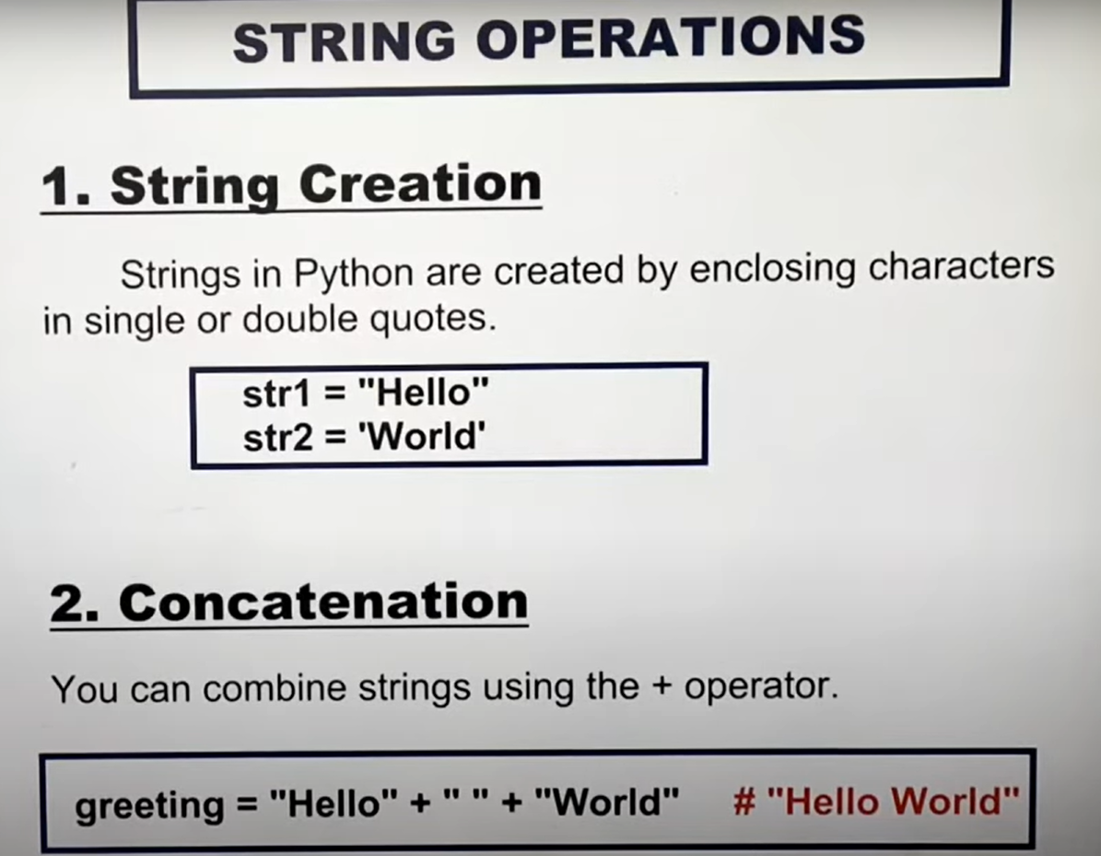

Slide 3
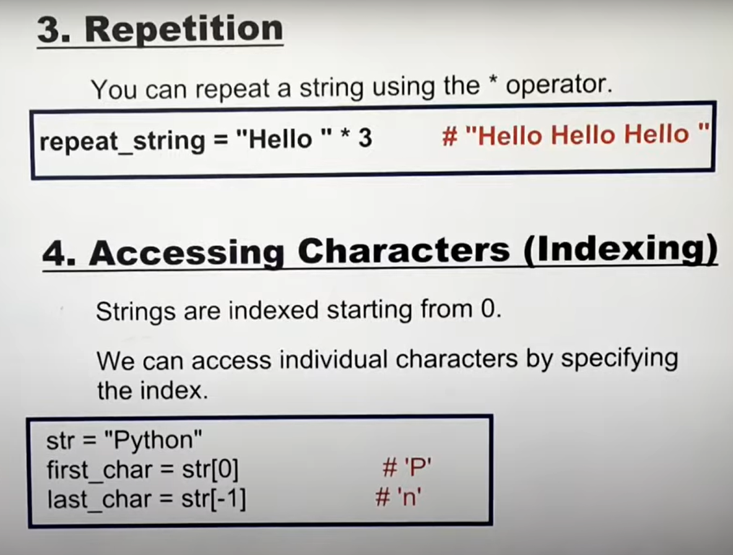

Slide 4
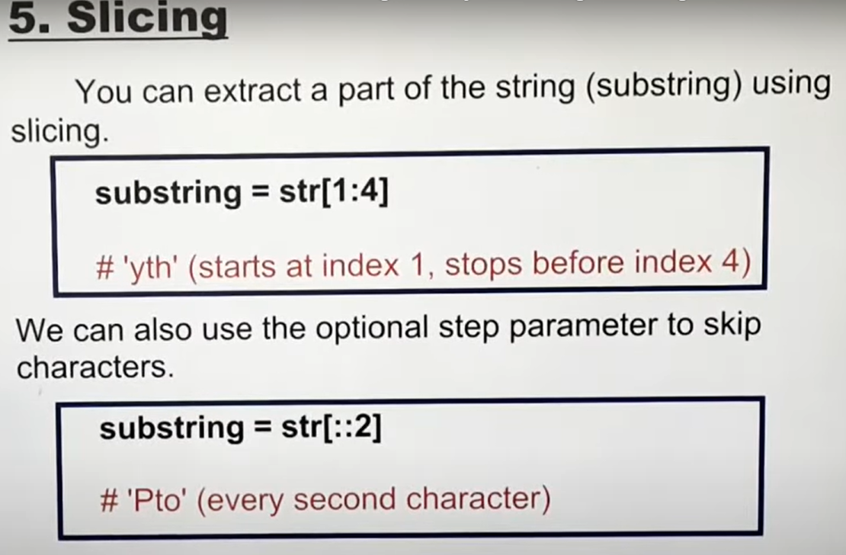

Slide 5
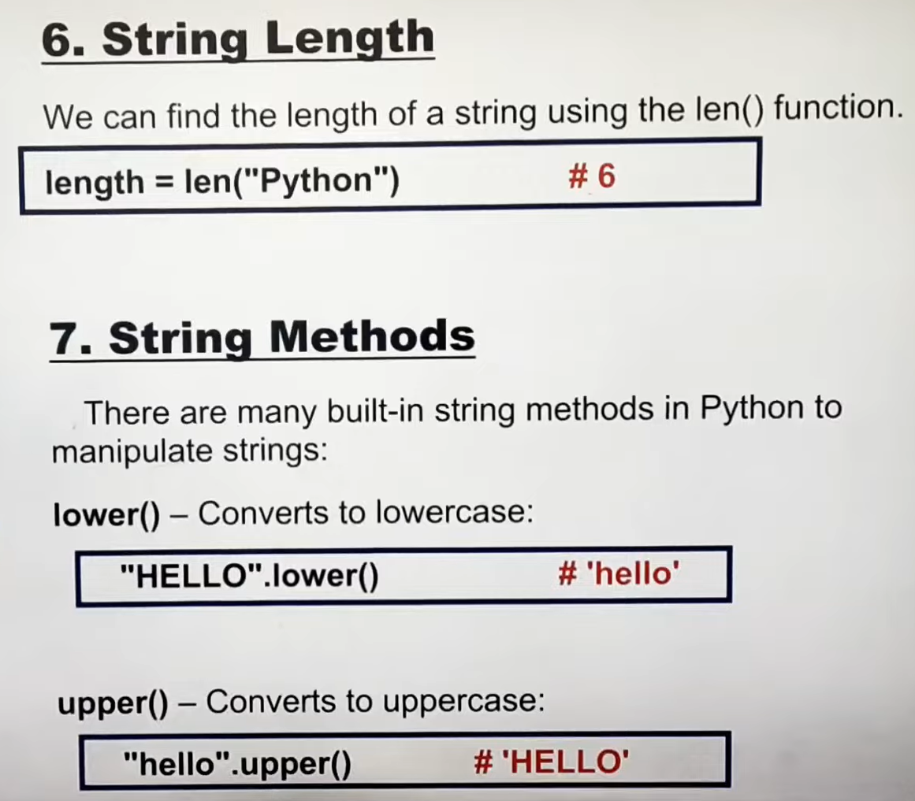

Slide 6
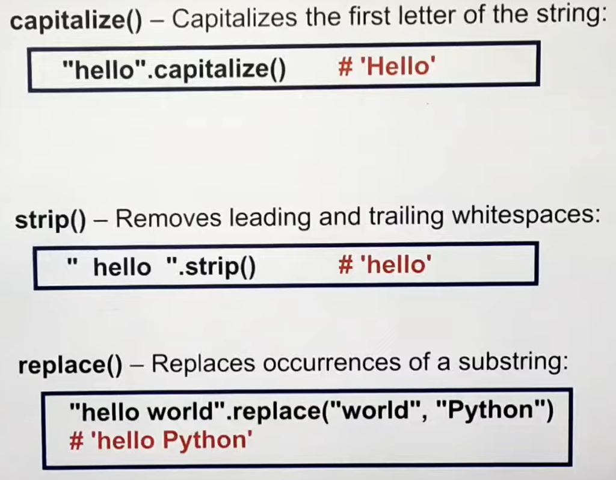

Slide 7
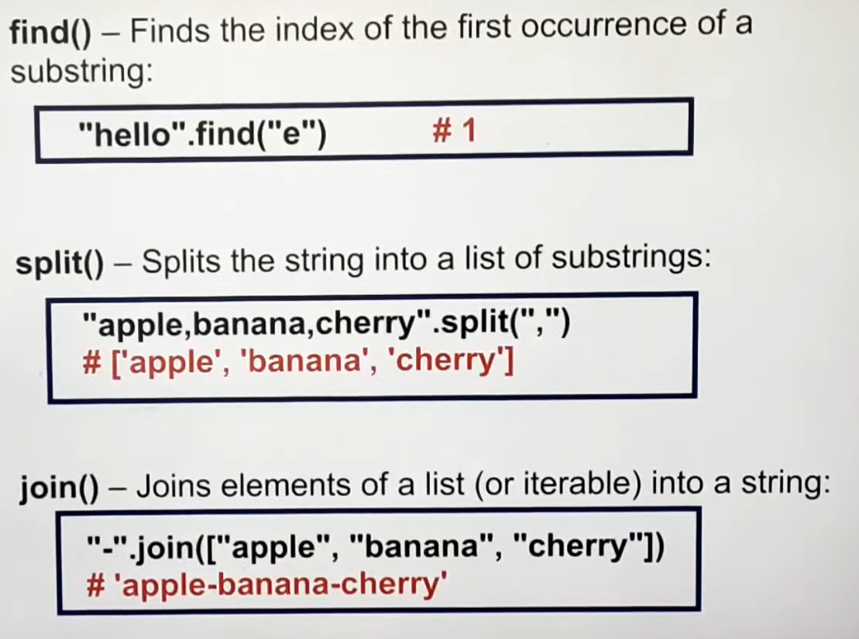

Slide 8


Slide 9
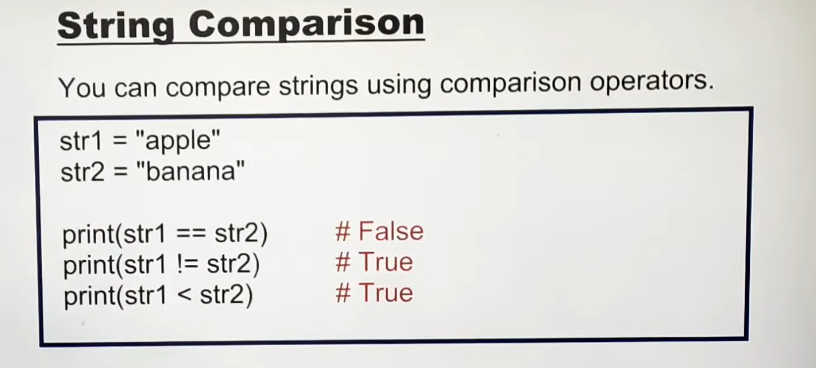

Slide 10
THANK YOU

